Slide 1

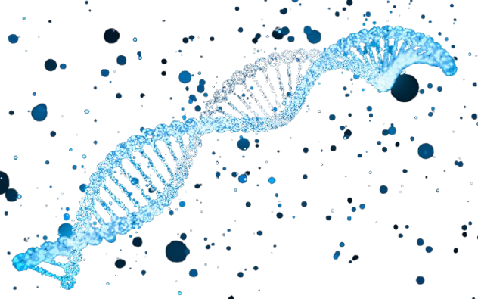
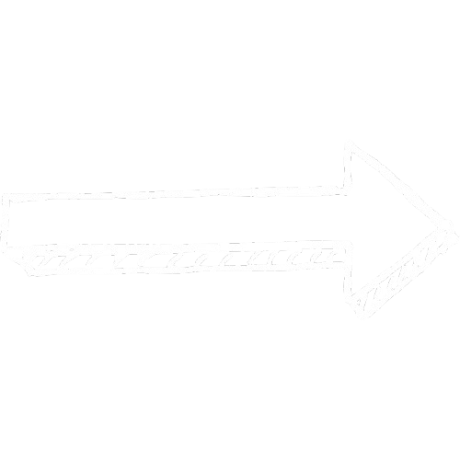
Sources
Altschul et al., 1990 (BLAST)
International Human Genome Sequencing Consortium, 2001/2004 (HGP)
BLAST – Sequence alignment
Human Genome Project
Explosion of genomic data
Shift: Alignment to learning patterns

Slide 2

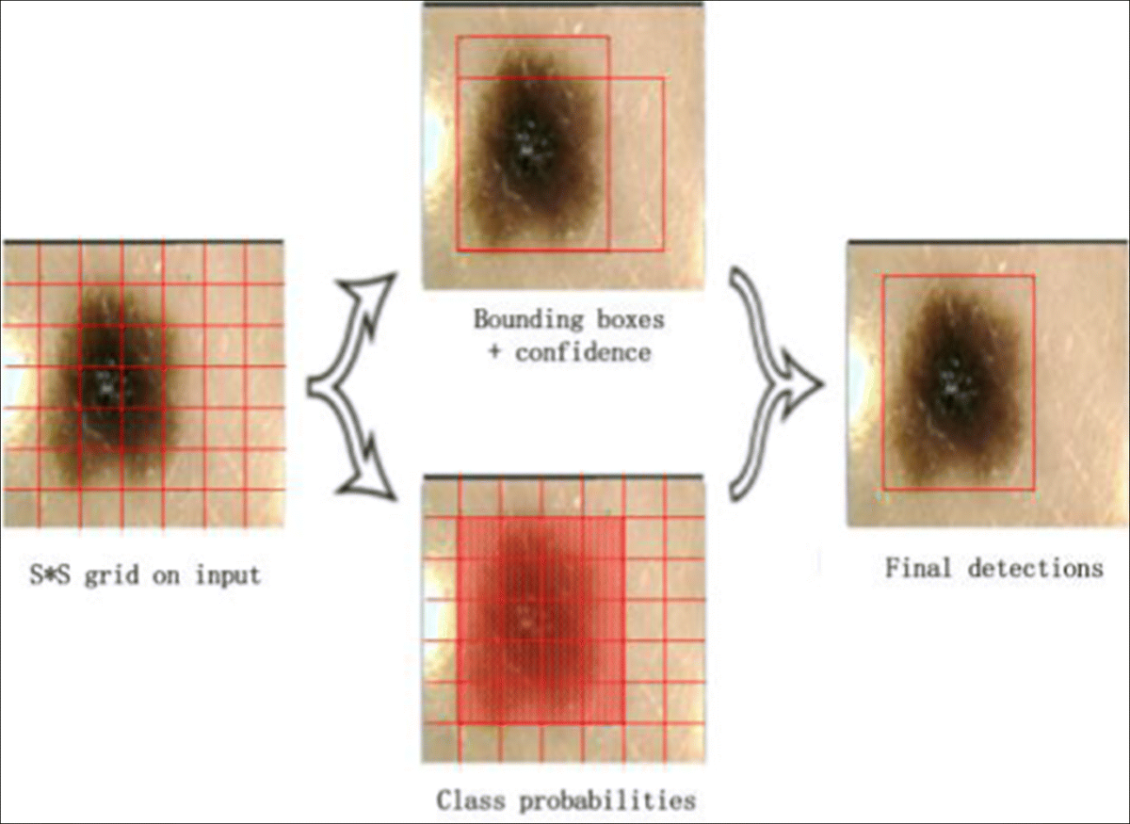
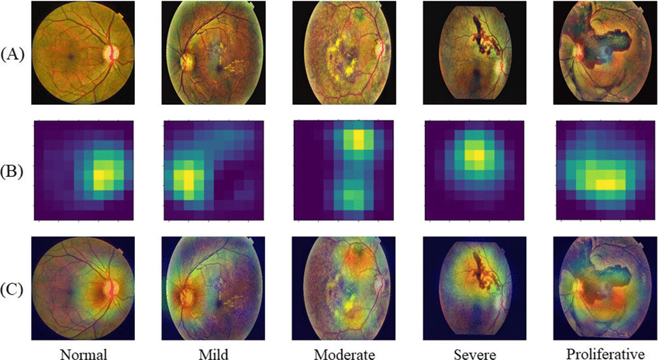
Disease Diagnosis
Sources
Gulshan et al., 2016 (Google DR)
Esteva et al., 2017 (Stanford skin cancer AI)
Ji et al., 2021 (DNABERT)
Source: Zhang et al., "Hinge attention network: A joint model for diabetic retinopathy severity grading," Applied Intelligence, 2022.
Source: Quantpedia – “BERT model (Bidirectional Encoder Representations from Transformers)”, accessed 5 Oct 2025
Source: Bian, X., Pan, H. and Zhang, K. et al. (2022) ‘Skin lesion image classification method based on extension theory and deep learning’, Multimedia Tools and Applications, 81, pp. 16389–16409.

Slide 3
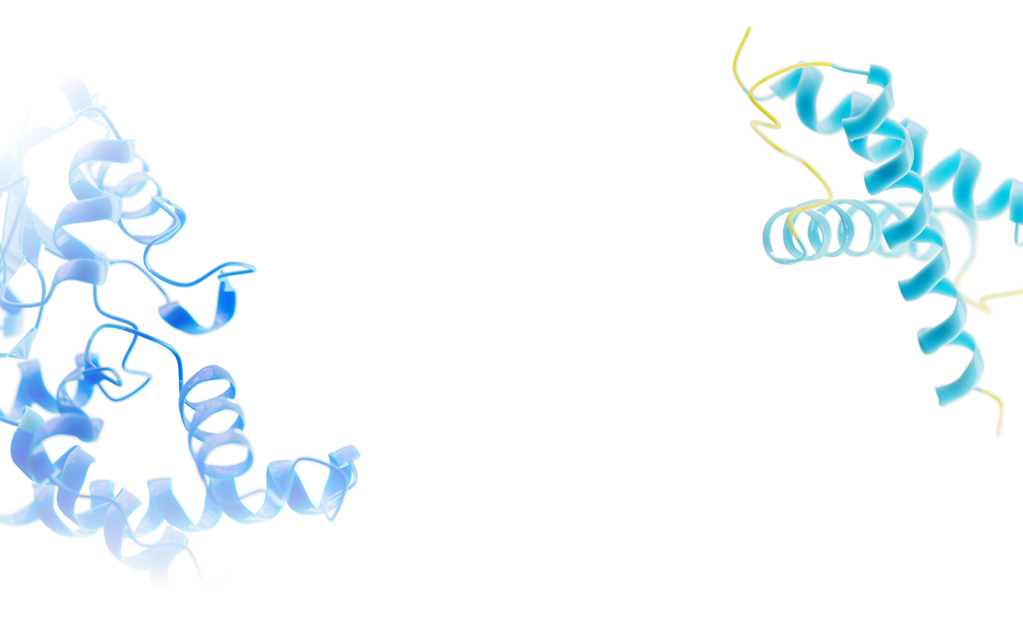
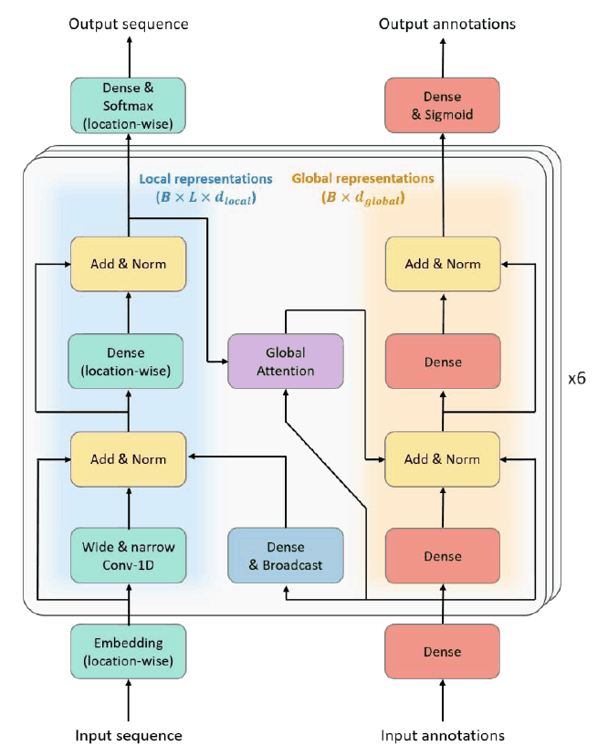

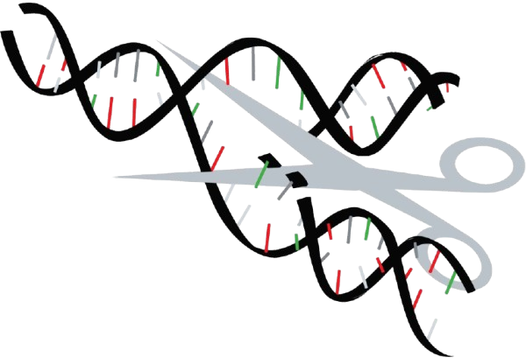
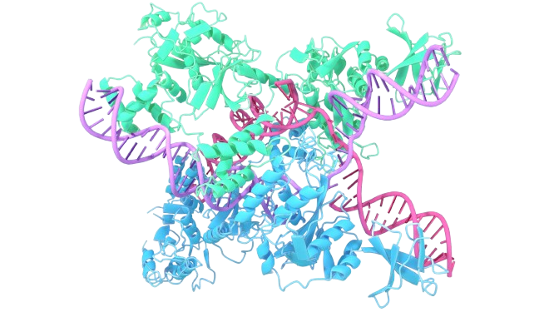

Drug discovery and personalised medicine
Sources
Jumper et al., 2021 (AlphaFold 2, Nature)
Brandes et al., 2022 (ProteinBERT)
Doench et al., 2016 (Azimuth, Nature Biotechnology)
Listgarten et al., 2018 (Elevation, Genome Biology)
Azimuth
Elevation
Source: Brandes, N., Ofer, D., Peleg, Y., Rappoport, N. and Linial, M. (2022) ‘ProteinBERT: a universal deep-learning model of protein sequence and function’, Bioinformatics, 38(8), pp. 2102–2110.
Brandes, N., Ofer, D., Peleg, Y., Rappoport, N. and Linial, M. (2022) ‘ProteinBERT: a universal deep-learning model of protein sequence and function’, Bioinformatics, 38(8), pp. 2102–2110.

